Slide 1
Python Script for Overarm Motion Analysis Using 3D Motion Capture Data
By Isiah Turner

Slide 2
Summary
Motion Capture
Motion capture within biomechanics research
The open-source community for analyzing motion capture data
The limitations with the open-source community
Methodology
Closing Remarks

Slide 3
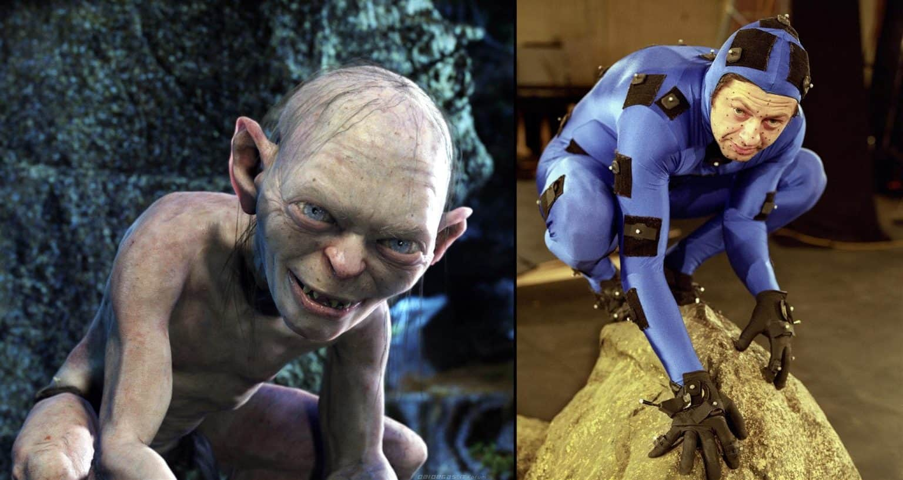
What is Motion Capture?
History
Motion capture can be tracked to as early as 1882
Evolution of Motion Capture
Movies
Video Games
Research
(“How Markerless Motion Capture Analysis Is Changing Musculoskeletal Recovery, Performance and Health | Kinetic Labs,” n.d.)

Slide 4
Analyzing 3D Motion Capture Data
Biomechanics Measurements
Open-Source Analysis Tools
Biomechanical ToolKit
BiomechZoo
Clinical Movement Analysis Society
Upper Extremity versus Lower Extremity Analysis
Lower body dominant
Knee vs Shoulder
Pay wall

Slide 5
Purpose of the Python Script
Create an open-source suite capable of analyzing the upper extremity’s 3D kinematics
Designed with a flexibility that allows analysis for various purposes

Slide 6
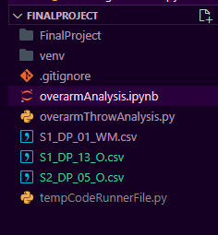
Methodology: Import Function
Purpose:
Imports a folder’s .csv files that contain the motion capture data in C3D format
Data Handling
Utilizes the Pandas module
Notes:
Based off open-source 3D motion capture data for overarm throwing

Slide 7
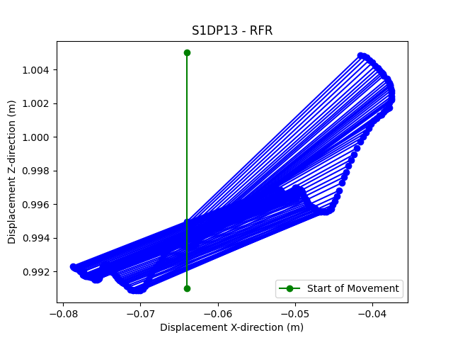
Methodology: graphSegment Function
Purpose:
Visualizes a segment’s movement over time
Utilizes Matplotlib module
Inputs:
Pandas Dataframe
4 Columns (coordinates for 2 points)
Start frame
End frame

Slide 8
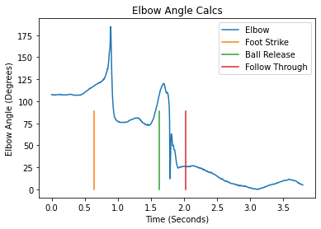
Methodology: sagittalJointAngle Function
Purpose:
Calculates and visualizes the angle for a joint
Utilizes Matplotlib and Numpy modules
Inputs:
Pandas Dataframe
8 Columns (coordinates for 4 points)
Notes:
Picture of an angle being calculated using arctan2
Picture of our output

Slide 9
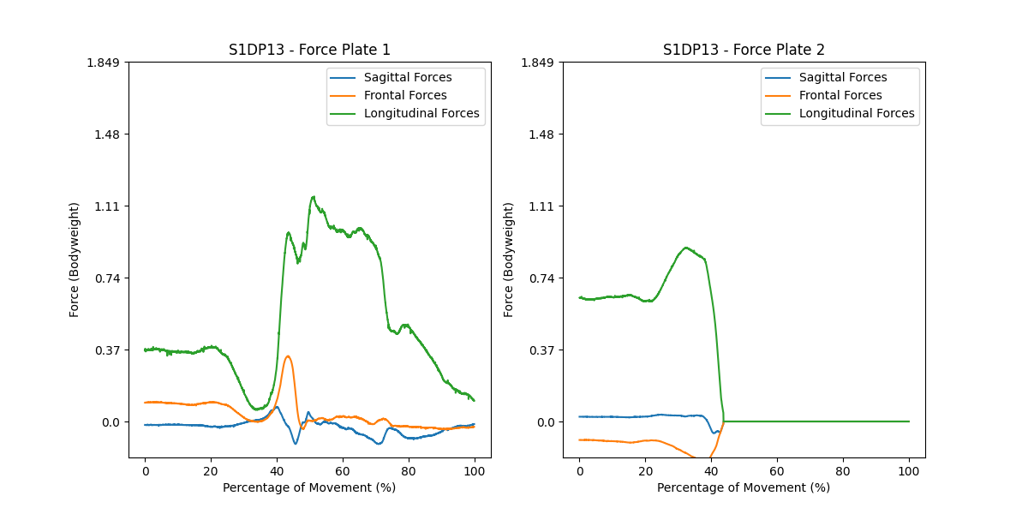
Methodology: visualizingForces Function
Purpose:
Visualizes the forces of two force plates
Utilizes Matplotlib
Inputs:
Pandas Dataframe
Title Name

Slide 10
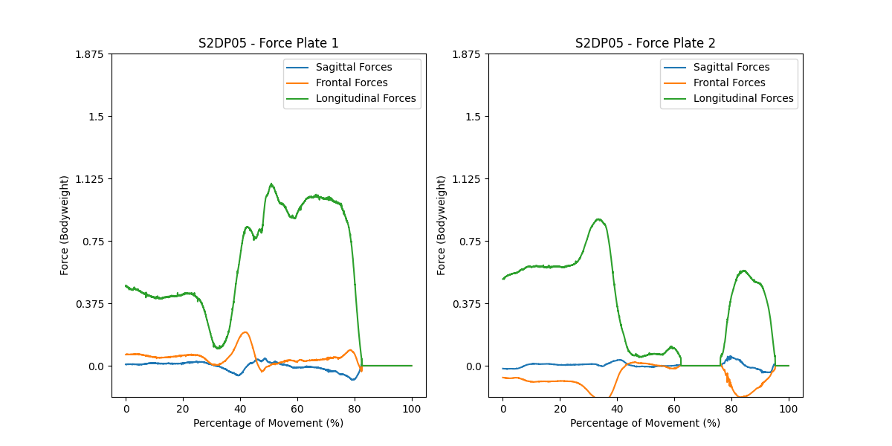
Methodology: Comparison Functions
Purpose:
compares the visualizations between subjects for easier comparison
Produce reports
Inputs:
Any number of Pandas dataframes

Slide 11
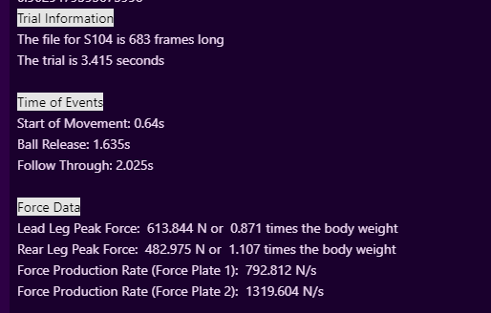
Methology: Comparison Functions

Slide 12
Closing Remarks
Script is currently able to import, analyze and visualize motion capture data of the upper extremity as well as force plate data.
What’s next?
Targeted audience

Slide 13
Questions?

